Slide 1
ReferenceWire/FastWire Overview
NEWS TECHNOLOGY
Company Confidential

Slide 2
Agenda
ReferenceWire
FastWire
Development process

Slide 3
ReferenceWire
Objectives
  Assess, rationalize and re-platform the current reference wire feeds for use by editorial staff.
  Remove dependency on S77 as a middle tier to deliver content, so it can be retired.

Slide 4
ReferenceWire
Requirements
  Low latency
    Delivery typical news (20 KB) within 50 ms
  Robustness
    Run business 24 * 7
  Scalability
    Scale up (Vertically)
    Scale out (Horizontally)

Slide 5
ReferenceWire – Low latency

Slide 6
ReferenceWire – Low latency

Slide 7
ReferenceWire – Low latency
Future plan
  Enhance our thread model
    .NET TPL library
    Async programming in C# 5.0
  Enhance transmission
    Windows Web Service API
    Encoding above WCF
    Compression

Slide 8
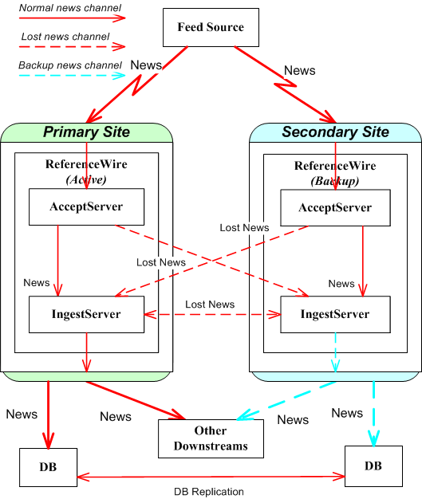
ReferenceWire – Robustness
Receive and Normalize news
Arbitrate and Delivery news to downtream

Slide 9
ReferenceWire – Robustness
AcceptService and IngestService run in different machines.
Either of AcceptServices ( or IngestServices) fails, the system run smoothly.
Lost news will be monitored and resent.
  If lost news is detected, the news will be resent.
Service status is monitored, too.
  If another service is detected fault, a recovery action will be triggered automatically.

Slide 10
ReferenceWire – Scalability
Scale up (Vertically)
  Enhance thread mode
    TPL library
    Async library
Scale out (Horizontally)
  Introduce load balance functionality
    Single IngestService for Multiple AcceptService

Slide 11
ReferenceWire – Current status
ReferenceWire Frameworks is code completed;
S77Editorial, S77ThirdParty and Quantum is code completed;
NRG, WireEngine, FingerPost are under construct;

Slide 12
FastWire
Objective
  Collect the content from 3rd parties to S&A system

Slide 13
FastWire
Requirement
  Ultra low latency
    Delivery headline within 10 ms
    Delivery full story with 50 ms

Slide 14
FastWire – Ultra low latency
Headline
Full story

Slide 15
FastWire – Ultra low latency
Future plan
  Evaluate the Elektron Quantum Framework

Slide 16
FastWire – Current status
LSE RNS feed is code complete;
NRG feed will be the next one;
Elektron Quantum Framework is under evaluation;

Slide 17
Conclusion
Comparison between ReferenceWire and FastWire
 | ReferenceWire | FastWire
Feeds | News agency | Stock exchange
Implementation | C# | C++
Deployment | 4 VMs | 1 Physical machine
Latency | Low latency (50ms) | Ultra low latency (within 10 ms)
Output | Full story only | Headline + partial message + full story
Downstream | Lynx + S&A | S&A

Slide 18
Development process
Follow Agile process
  Use Rally to manage the process
  Have daily scrum meeting
  Typically 1 month per iteration

Slide 19
Q & A

